Slide 1
SeniorPro
A dedicated digital assistant for the elderly/those in need and/or their caregivers
Grandparents' health just a click away!

Slide 2

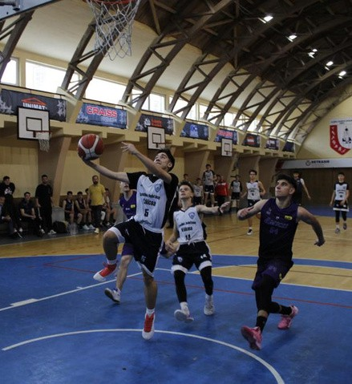
Who I am?
Name: Mihai Arișanu
School: National College Mircea cel Bătrân, Rm. Vâlcea
Profile: Mathematics-Informatics
Grade: X
Hobbies: technology, basketball, painting
Social Skills: communication teamwork
conflict resolution empathy
relationship management
respect

Slide 3
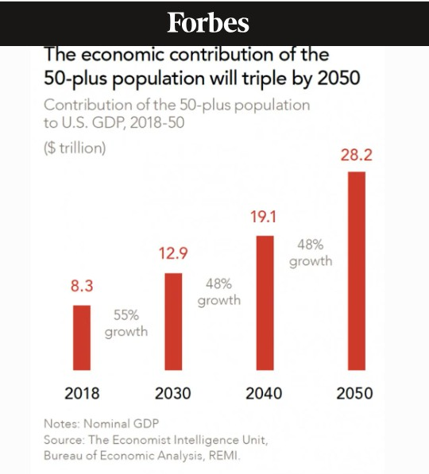
What problem I am solving?
The mission is to create an innovative, easy-to-use application that help the elderly and/or their relatives,
monitor their health and create a sense of well-being.

Slide 4
Market research
Applications with Similar Functions:
Medication Reminder: Medisafe and CareZone aim to provide users with reminders for taking their medications and tracking their health status.
Applications for People with Diabetes: mySuger - Diabetes Tracker Log is similar to Senior Pro in its function for logging blood glucose levels and creating charts. It also includes additional features such as a food and activity journal, and reminders for insulin administration.
Blood Pressure Monitors: HeartWise Blood Pressure Tracker that aim solely to assist in recording and noting blood pressure.
SeniorPro:
it has an intuitive interface with large fonts and graphics. it integrates multiple functionalities.
it is continuously evolving.
it is created by grandchildren for grandparents.

Slide 5
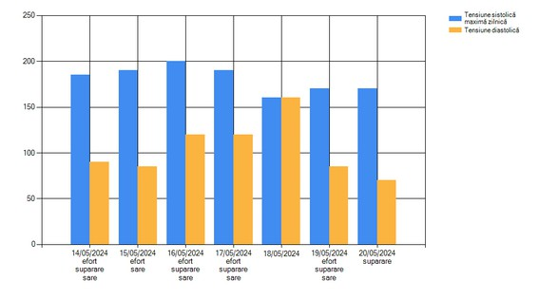
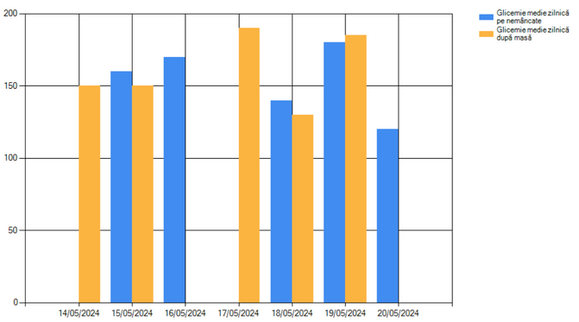
Functionalities
Recording blood glucose, blood pressure, and weight Monitoring parameters by displaying/saving charts for the recorded parameters
Well-being enhancement by displaying unforgettable memories Notifications for the anniversaries of loved ones
Displaying treatment plans

Slide 6
Technologies
SeniorPro is a ·C# application with SQL Server Database
Technology is the art that transforms sciences into something practical Marcio Barros

Slide 7
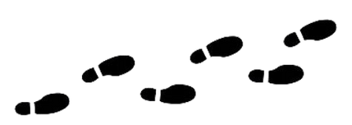
Next steps
send charts and statistics directly to doctor(s)
sending warning SMS when the parameters exceed the set limits AI ChatBot for seniors to chat with by text or voice
version for phones/tablets
mini tutorials for balance exercises reminders for treatment and exercises
add the functionality for visually impaired users

Slide 8

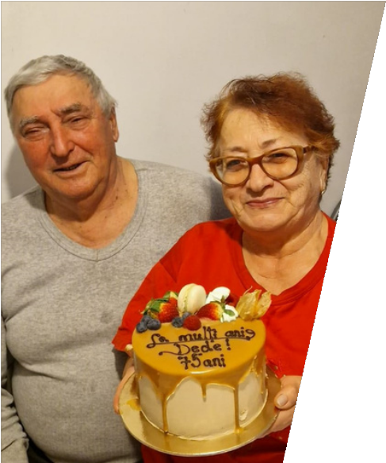
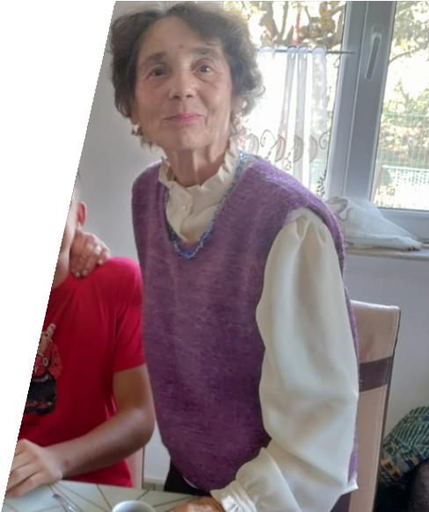
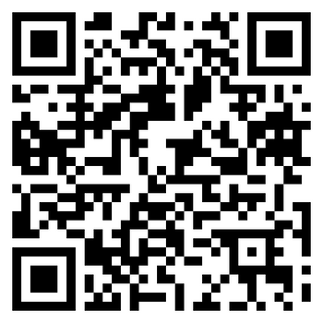
Special thanks
to:
my grandparents
my computer science teachers everyone who sends suggestions
Contact:
Mihai Arișanu mihai.arișanu2006@gmail.com 0770849156

